Slide 1

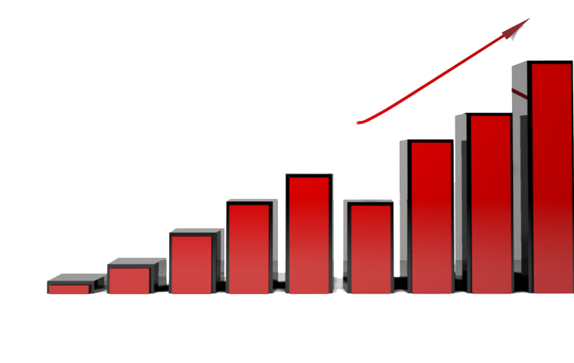
Time Series Analysis and Forecasting
Prepared By:
Milan Maharjan (072BEX426)
Ravi Kiran Aryal (072BEX434)
Tejasvi Raj Pant (072BEX447)
Tribikram Panthi (072BEX448)

Slide 2
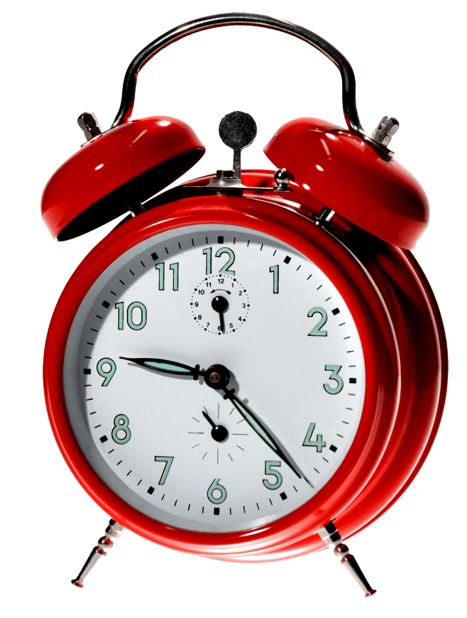

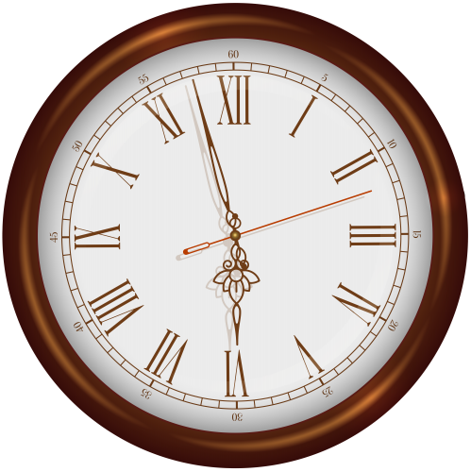
Agenda for Today
1
Time Series
2
Why and When?
3
Components of Time Series
4
Stationarity
5
Time Series Analysis
6
Time Series Forecasting

Slide 3
Time Series
Time Series is a series of observations taken at specified equal intervals of time.
For e.g.: Population data taken in every decade

Slide 4
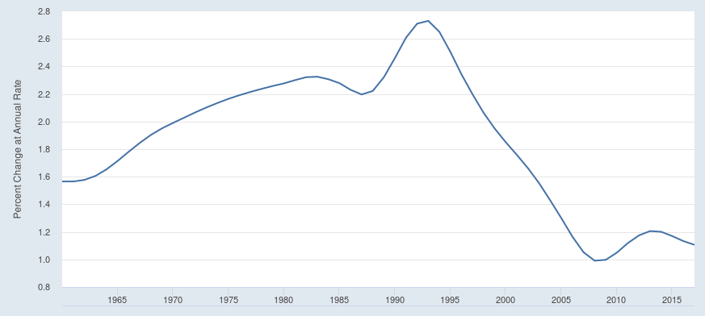
Time Series
Figure: Population Growth Rate of Nepal from 1960 to 2018

Slide 5
Time Series
In time series, we have only one variable: given observation
This variable changes in correlation with time

Slide 6
Time Series
Time Series Analysis:
Performing mathematical and graphical analysis on time series data so that we can understand and interpret the data properly

Slide 7
Time Series
Time Series Forecasting:
We can use past and current values to predict the future values of time series. This is known as Time Series Forecasting

Slide 8

Agenda for Today
1
Time Series
2
Why and When?
3
Components of Time Series
4
Stationarity
5
Time Series Analysis
6
Time Series Forecasting

Slide 9
Why to Use Time Series Analysis and Forecasting?
Business Forecasting
Understand past behavior
Plan the future
Evaluate current accomplishment
and Many More other reasons…

Slide 10
When to Use Time Series Analysis?
If the factors affecting the observation doesn’t change suddenly with time.
When the time series is Auto Regressive in nature.

Slide 11
When not to Use Time Series Analysis?
If the observed series can be represented completely by mathematical functions.
If observed values are affected by other factors which change abruptly.

Slide 12
Agenda for Today
1
Time Series
2
Why and When?
3
Components of Time Series
4
Stationarity
5
Time Series Analysis
6
Time Series Forecasting

Slide 13
Components of Time Series
Trend
Seasonality
Cyclicity
Noise or Irregularity

Slide 14
Components of Time Series
Trend
General direction in which time series is moving
Either Up trend, Down trend or No trend

Slide 15
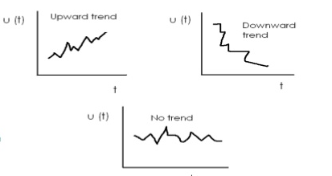
Components of Time Series
Trend

Slide 16
Components of Time Series
Seasonality
Periodic (or regular rise and fall) in time series.
Factors affecting seasonality are
Climate/weather condition
Custum tradition and habit

Slide 17
Components of Time Series
Seasonality
Seasonal variations usually have period not more than 1 year.
Example
Demand for warm clothes goes high in winter
Rise in sell of sweets in Tihar.

Slide 18
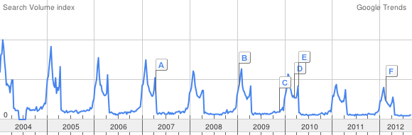
Components of Time Series
Seasonality

Slide 19
Components of Time Series
Cyclicity
Non –periodic fluctuations in time series.
Cyclic variations usually last longer than a year

Slide 20
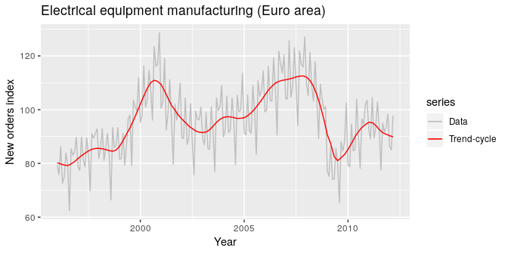
Components of Time Series
Cyclicity

Slide 21
Components of Time Series
Cyclicity
Eg – A business cycle
A business cycle where the length of the cycle is unknown beforehand
Business cycle is not periodic in nature

Slide 22
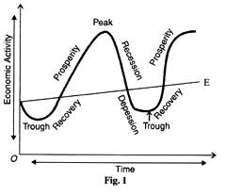
Components of Time Series
Business Cycle- An example of cyclicity

Slide 23
Components of Time Series
Irregularity
Random variations in time series
Do not repeat in a definite pattern
Caused by unexpected events such as earthquake, flood etc
Unpredictible in nature

Slide 24
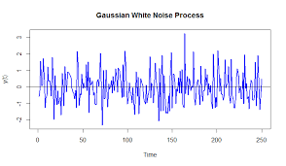
Components of Time Series
Irregularity or Noise

Slide 25
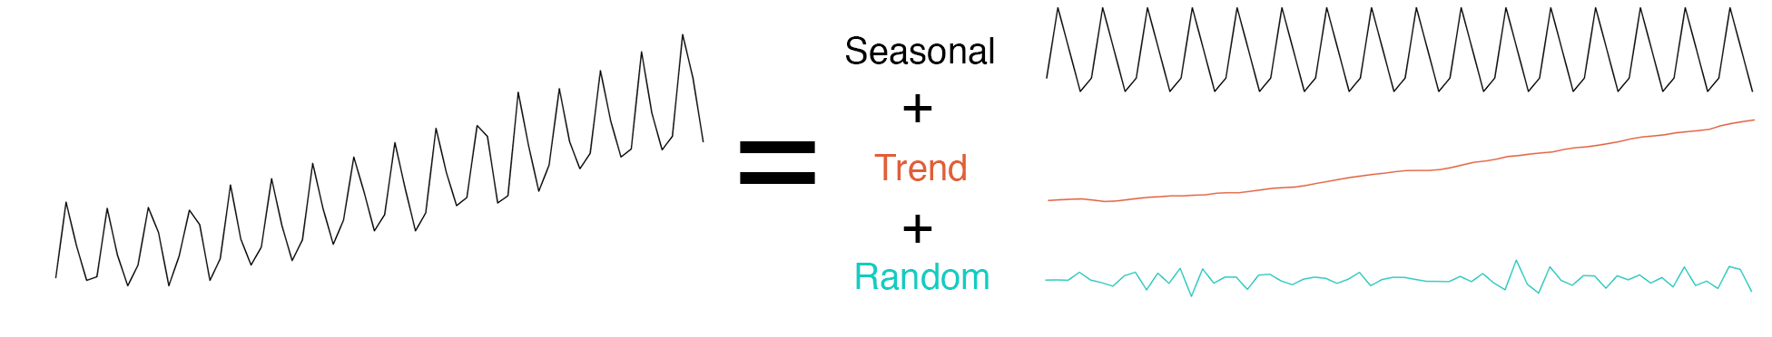
Components of Time Series
Extracting Components from Time Series

Slide 26
Agenda for Today
1
Time Series
2
Why and When?
3
Components of Time Series
4
Stationarity
5
Time Series Analysis
6
Time Series Forecasting

Slide 27
Stationarity
Strict Stationarity
Joint Probability Distribution of occurrence of values doesn’t change with time

Slide 28
Stationarity
Weak Stationarity
It should have constant mean.
It should have constant variance or standard deviation.
Auto-covariance should not depend on time.

Slide 29
Stationarity
Stationarity is desired property:
Because for stationary signal, probability distribution is independent of time shift. Thus, future values can be predicted with more accuracy.

Slide 30
Agenda for Today
1
Time Series
2
Why and When?
3
Components of Time Series
4
Stationarity
5
Time Series Analysis
6
Time Series Forecasting

Slide 31
Time Series Analysis
Finding the trend
There are many ways for doing it. Some of them are as follow:
Curve Fitting
Plotting the moving average

Slide 32
Time Series Analysis
Finding the Seasonality
There are many ways for doing it. Some of them are as follow:
Fourier Series Analysis
Autocorrelation Analysis

Slide 33
Time Series Analysis
Noise and Cyclicity
They are generally unpredictable in nature. So, these components are difficult to trace.

Slide 34
Agenda for Today
1
Time Series
2
Why and When?
3
Components of Time Series
4
Stationarity
5
Time Series Analysis
6
Time Series Forecasting

Slide 35
Time Series Forecasting
Models for Time Series Forecasting
There are many models for doing it. Some of them are:
Auto-regression model (AR)
Moving average model (MA)
ARMA
ARIMA

Slide 36
Time Series Forecasting
Auto-regressive model
It is based on the principle, “Past determines the future”
Prediction of next value is done by regression of last “K” data

Slide 37
Agenda for Today
1
Time Series
2
Why and When?
3
Components of Time Series
4
Stationarity
5
Time Series Analysis
6
Time Series Forecasting

